Slide 1

Tour de Statistics Denmark (DST) - information, setup, and do's and don’ts.
Mikkel Porsborg Andersen
Ph.D, MSc.Public Health, BSc.Sports Science
Senior researcher and Special consultant in Datamanagement
Department of Cardiology, Nordsjællands Hospital, Hillerød, Denmark.
E-mail: mikkel.porsborg.andersen@regionh.dk

Slide 2
Overview
Introduction to the setup at Statistics Denmark (DST)
Demo of Heart.dk
Information on registries and variables
Demo of a Project Folder
Summary and take-home messages
“Tell me and I forget, teach me and I may remember, involve me and I learn.”
Benjamin Franklin
Slide 1 of 10

Slide 3
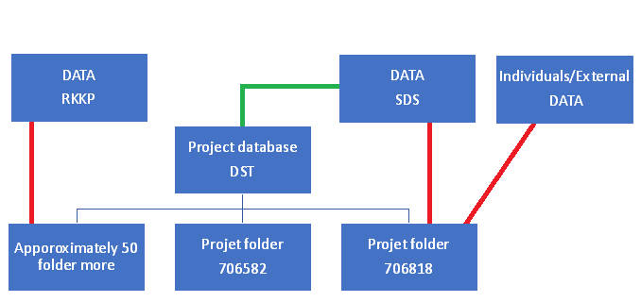
Introduction to the setup at Statistics Denmark (DST)
Approximately 350 users
Project folder structure
Data flow
Folder population
Reduce data
Slide 2 of 10

Slide 4
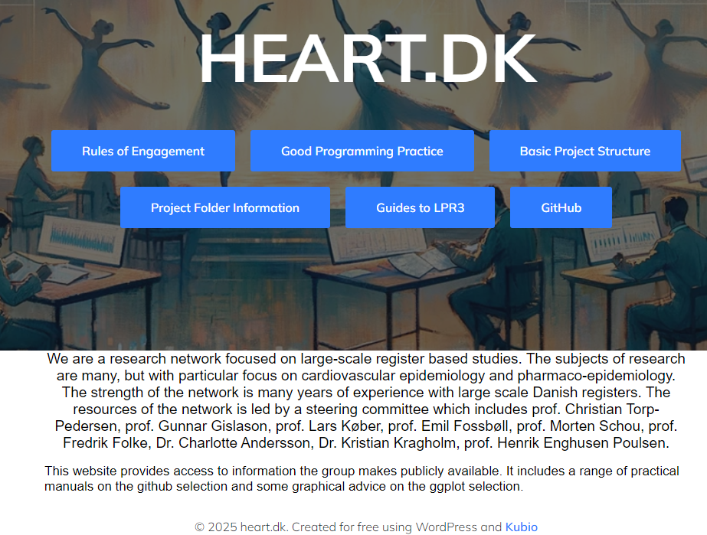
Demo of Heart.dk
Project descriptions of project folder
Dynamic update
Different guides in relation to the Heart.dk setup at DST
Rules of Engagement
Basic Project Structure
Demo on the information available
Link to Heart.dk and GitHub
Heart.dk
Github
Slide 3 of 10

Slide 5
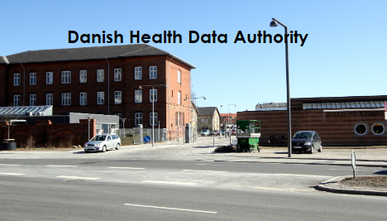
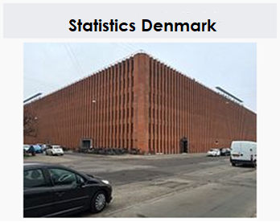
Information on registries and variables
There are two organizations that handles the Danish administrative registries
The Danish Health Data Authority(SDS) has the legal authority over the health registries
The Statistics Denmark (DST) has the legal authority over the social registries
Slide 4 of 10

Slide 6
Information on registries and variables
Registre descriptions
Variable descriptions
Datasource dependent
Health- vs. social registries
Links to informations on variables from:
Statistics Denmark (DST)
The Danish Health Data Authority (SDS)
Slide 5 of 10

Slide 7
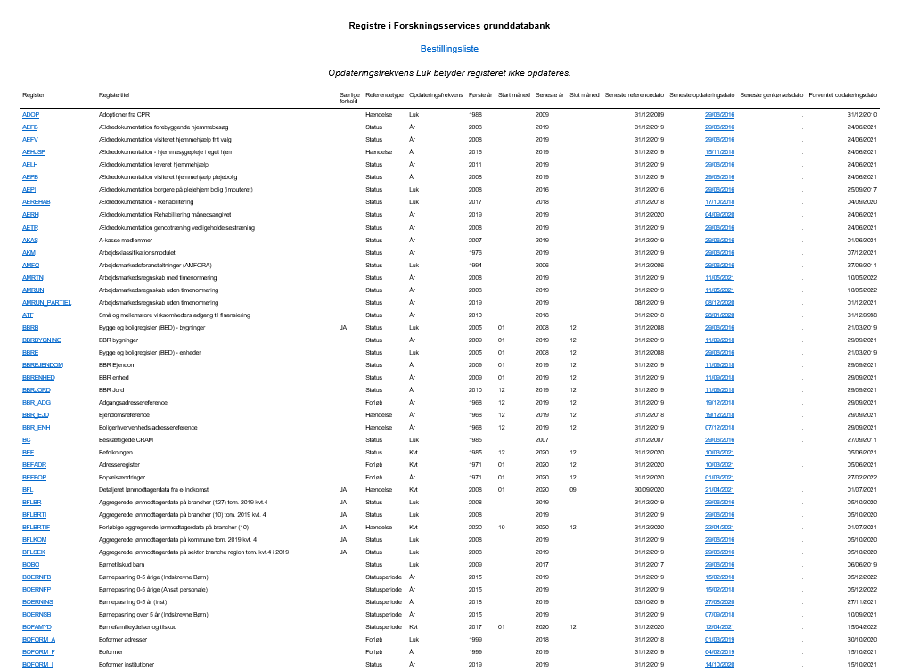
Information on registries and variables
Overview of registries at DST
Social registries
Information on each registry
Important links below:
Registry in Forskningsservices grunddatabank
Documentation
Income register - IND
Slide 6 of 10

Slide 8
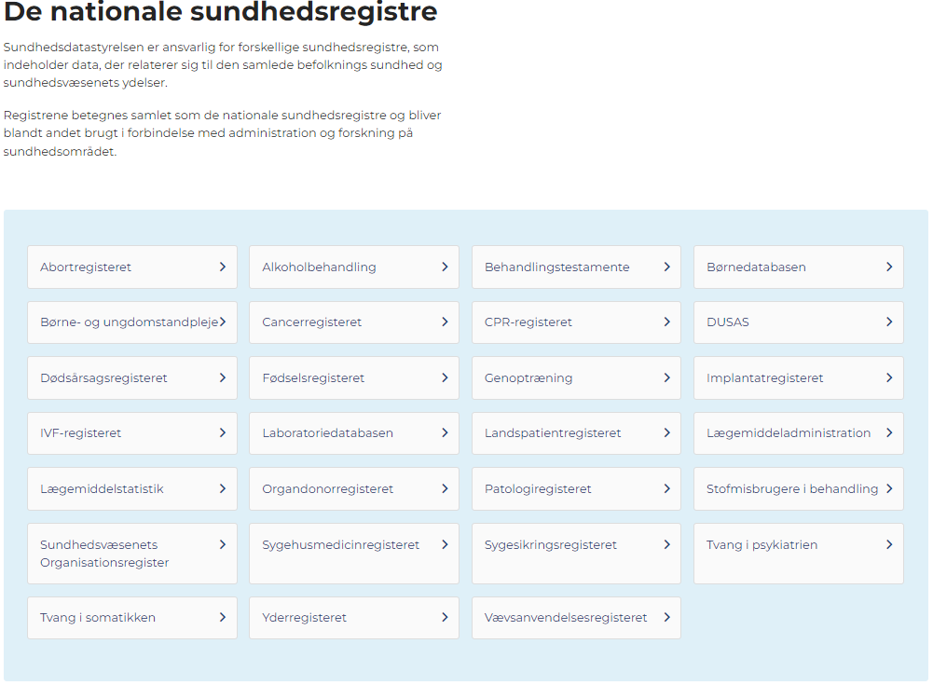
Information on registries and variables
Overview of registries at SDS
Health registries
Information on each registry
Important links below:
The national health registries
Documentation
The Danish National Patient Register (LPR2)
The Danish National Patient register (LPR3_F)
Brief instructions to LPR2
Brief instructions to LPR3_F
Slide 7 of 10

Slide 9
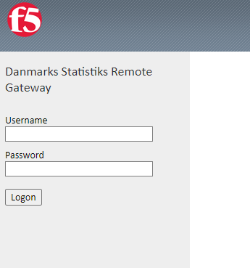
Demo of a Project Folder
Status info about DST
Project folder setup
Yearly update
Data localization
Demo on the information available
Link to DST and GitHub info
Log on etc.
DST
Project folder information
Slide 8 of 10

Slide 10
Summary and take-home messages
Always be aware of the task manager
Remember to check the task manager before signing out
Variable descriptions can be found either at SDS or DST
Manuals and other imported information can be found at Heart.dk
Answers to the most frequently asked questions can be found at Heart.dk
Always follow the rules stated in: “Rules of Engagement”
Slide 9 of 9

Slide 11

Questions or comments
Slide 10 of 10

